Slide 1

Sentiment Analysis
Reinforcement learning
Robert Horton
Gabriel Yeager

Slide 2
Introduction/Background
What is sentiment text analysis?
It is the use of natural language processing (NLP) and text analysis to identify and quantify subjective information pertaining to the text captured responses such as attitude, beliefs, opinions of the sample group.

Slide 3
Introduction/Background
Why is this useful?
It keeps businesses competitive
Evaluating marketing strategies specially though feedback from collected text data
Determining sentiment about public policy based on social media posts.

Slide 4
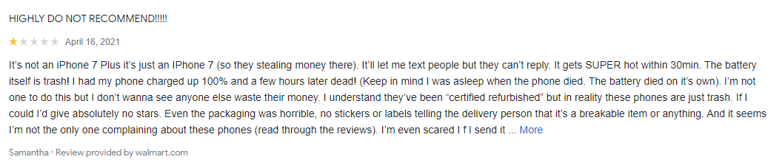

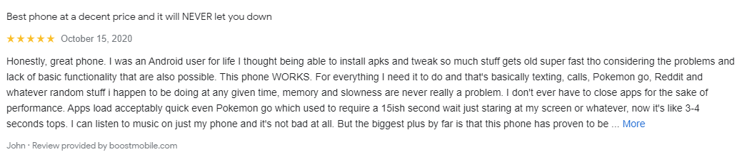

Introduction/Background
Unhappy customer left negative review about;
battery life.
heat from the device.
Happy customer left positive review about;
Software
‘Pokémon-Go’
Speed load up

Slide 5

Implementation
Software
Hardware
SciPy, Scikit-learn, Theano, Tensor Flow, Keras, PyTorch, Pandas, Matplotlib.
Computer

Slide 6
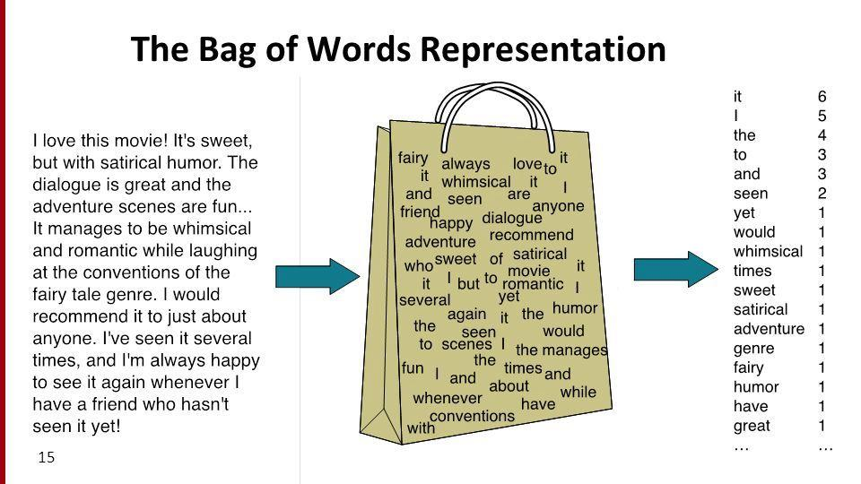
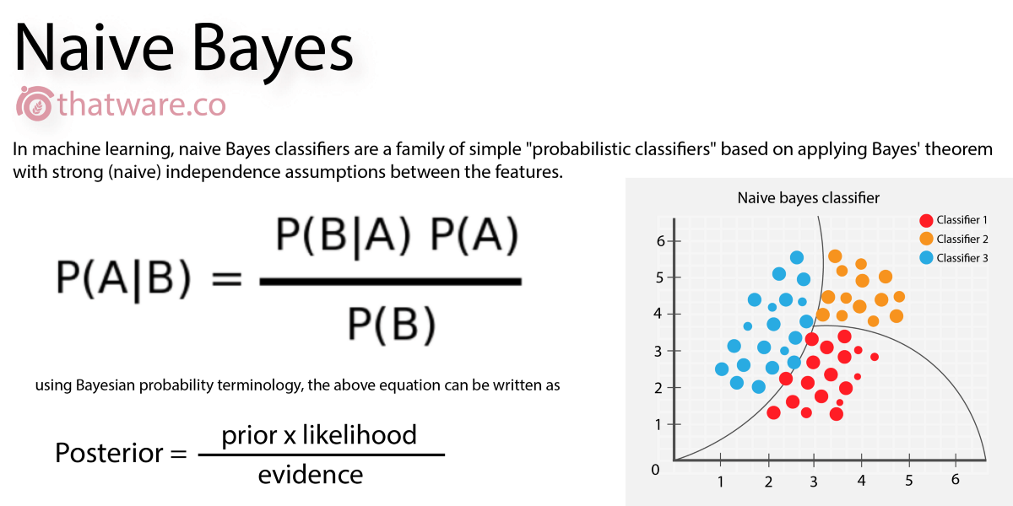
Methodology
Find good data sets for sentiment analysis
Amazon customer reviews, restaurant chains reviews.
Train a model with loaded in set
Several approaches;
‘Bag-of-Words-Model’
‘Naïve Bayes Classifier’
Analyze the two methods and;
Decipher what makes them different from one another?
Which is a more efficient model?
Which learns faster? Slower?
Which is most accurate? Why?

Slide 7

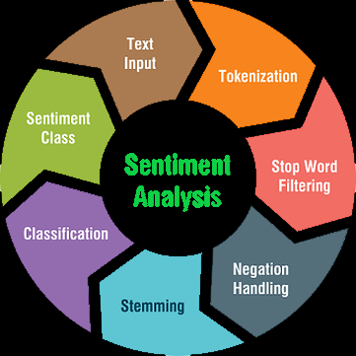

Text Input
Tokenization
Stop Word Filtering
Negation Handling
Stemming
Classification
Sentiment Class

Slide 8
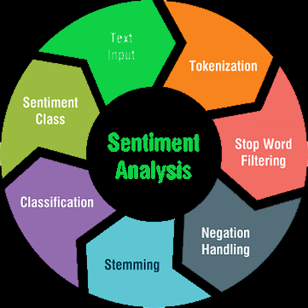


Text Input
Collecting and loading data, via data sets or data mining, into the machine learning models

Slide 9
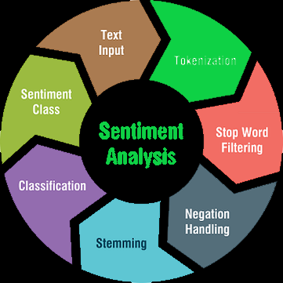
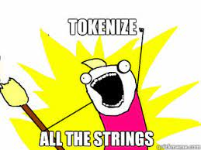
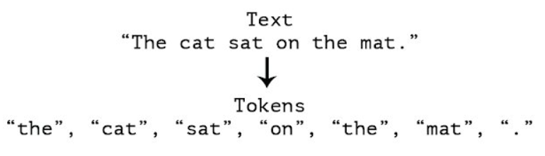
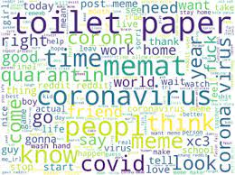
Tokenization
Breaking down the text for each episode by getting rid of non-word substrings and tokenizing the words in the text ingo smaller substrings for processing.

Slide 10
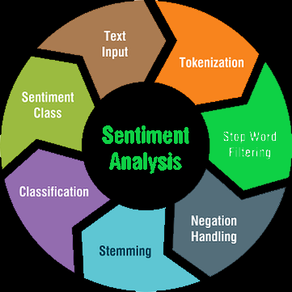
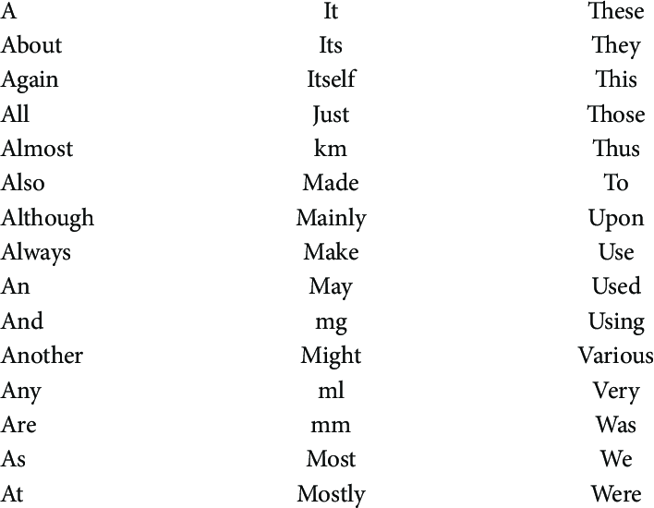
Stop Word Filtering
The set of defined “stop” words that constrain the meaning to a sub string comprised of other words that will then be processed for sentiment.

Slide 11
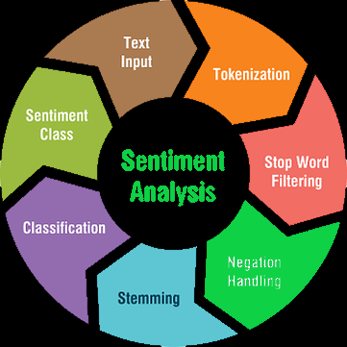
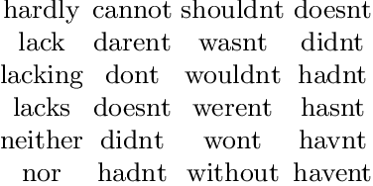
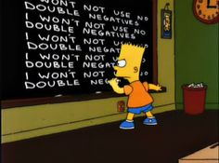
Negation Handling
A automated process in which the scope of negation and inverted polarities of opinionated words are affected by the order of the wording.

Slide 12
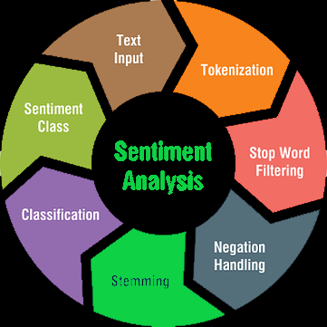
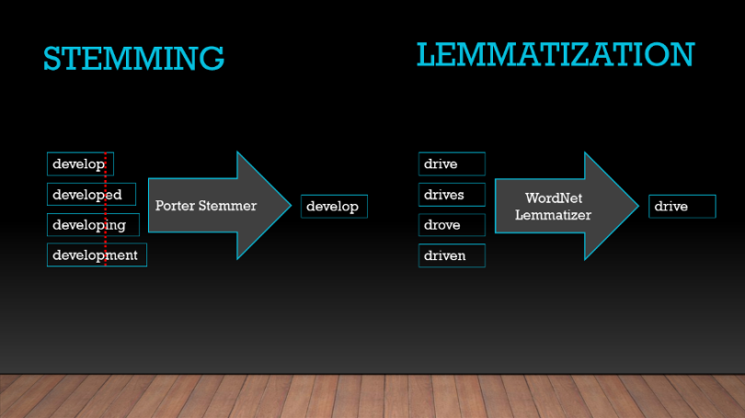
Stemming/Lemmatization
Process of editing and removing suffix’ from the end and/or beginning of the tokenized words so that the model can understand the meaning behind the word.

Slide 13
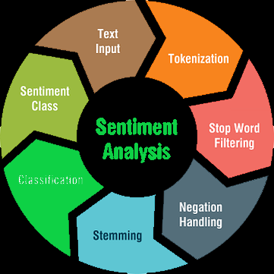
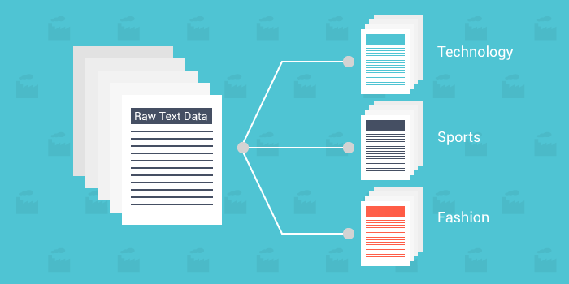
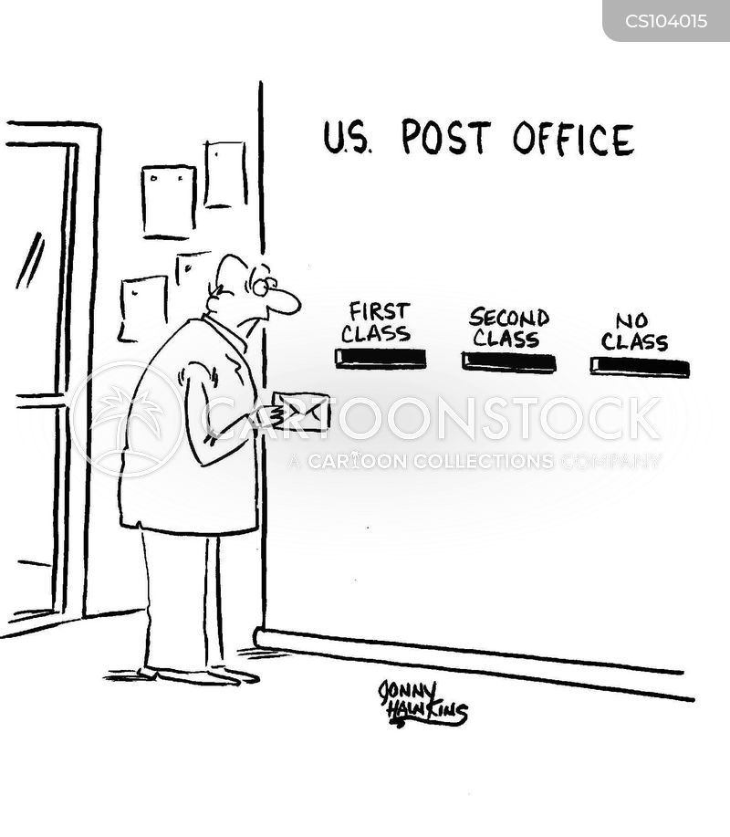


Classification
Process of breaking out the tokenized words into different sets.
Classification can fall under two types
Based off a NLP with a policy of pre-defined tags for word values
Based simply off a pre-comprised set of words with values assigned to them.

Slide 14
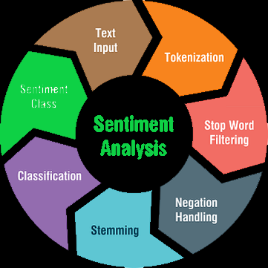
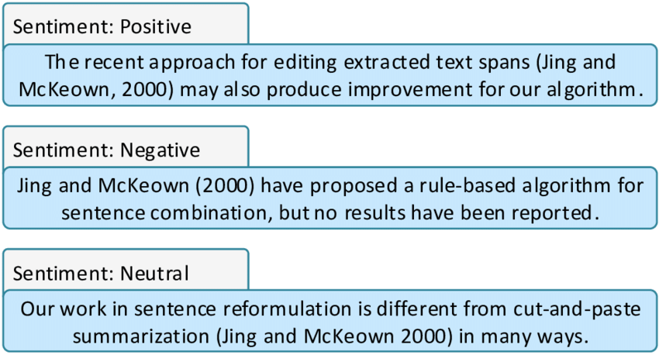

Sentiment Class
The learning process of determining sentiment categories expressed in text

Slide 15
Questions?

Slide 16
Thank You
References
https://www.kdnuggets.com/2015/12/sentiment-analysis-101.html
https://www.analyticsvidhya.com/blog/2020/05/what-is-tokenization-nlp/
https://www.datacamp.com/community/tutorials/simplifying-sentiment-
analysis-python
https://www.analyticsvidhya.com/blog/2020/12/understanding-text-classification-in-nlp-with-movie-review-example-example/
https://en.wikipedia.org/wiki/Sentiment_analysis
Images pulled from google and PowerPoint images
References
rhorton2@uccs.edu
gyeager@uccs.edu

